Slide 1
Entity-Relationship Model: PART 01
Course Code: CSC 2108
Course Title: Introduction To Database
Department of Computer Science
Faculty of Science and Technology
Lecture No: | 05 | Week No: | 03 | Semester: | Summer23-24
Lecturer: | Nazia Alfaz

Slide 2
Lecture Outline
ER Diagram
Alternative ER Notation
Participation
Cardinality Limits
Keys
Weak Entity Set
Generalization
Specialization
Aggregation

Slide 3
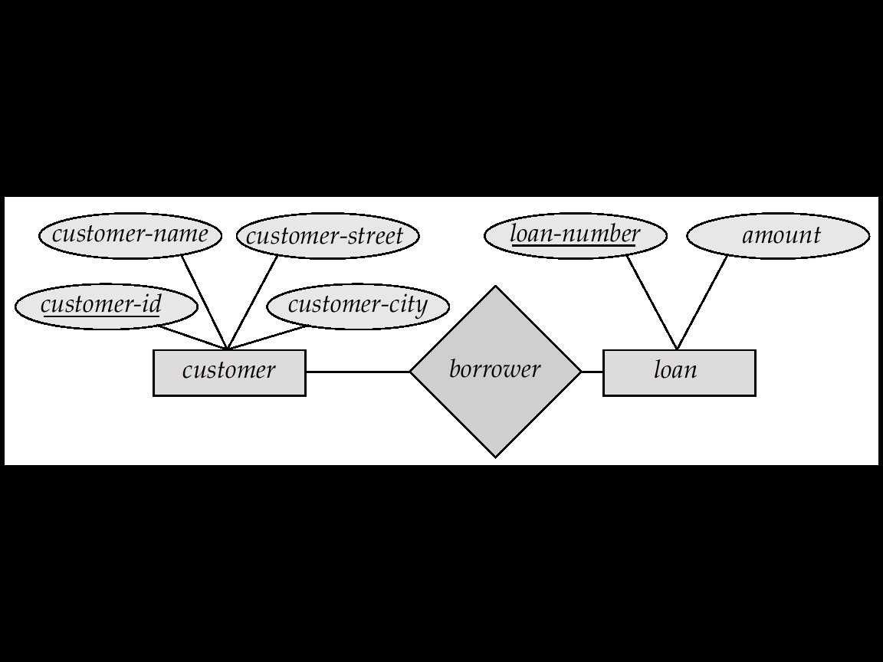
ER Diagram
Notation
Rectangles represent entity sets.
Diamonds represent relationship sets.
Lines link attributes to entity sets and entity sets to relationship sets.
Ellipses represent attributes
  Double ellipses represent multivalued attributes.
  Dashed ellipses denote derived attributes.
Underline indicates primary key attributes

Slide 4
ER Diagram
Entity Sets
A database can be modeled as a collection of entities or
relationship among entities.
An entity is an object that exists and is distinguishable from other objects. Example: specific person, company, event etc.
Entities have attributes. Example: people have names and addresses
An entity set is a set of entities of the same type that share the same properties. Example: set of all persons, companies, trees, holidays

Slide 5
ER Diagram
Attributes
An entity is represented by a set of attributes, that is descriptive properties possessed by all members of an entity set.
Domain is the set of permitted values for each attribute
Entity | Attributes
customer | customer-id, customer-name, customer-street, customer-city
loan | loan-number, amount

Slide 6
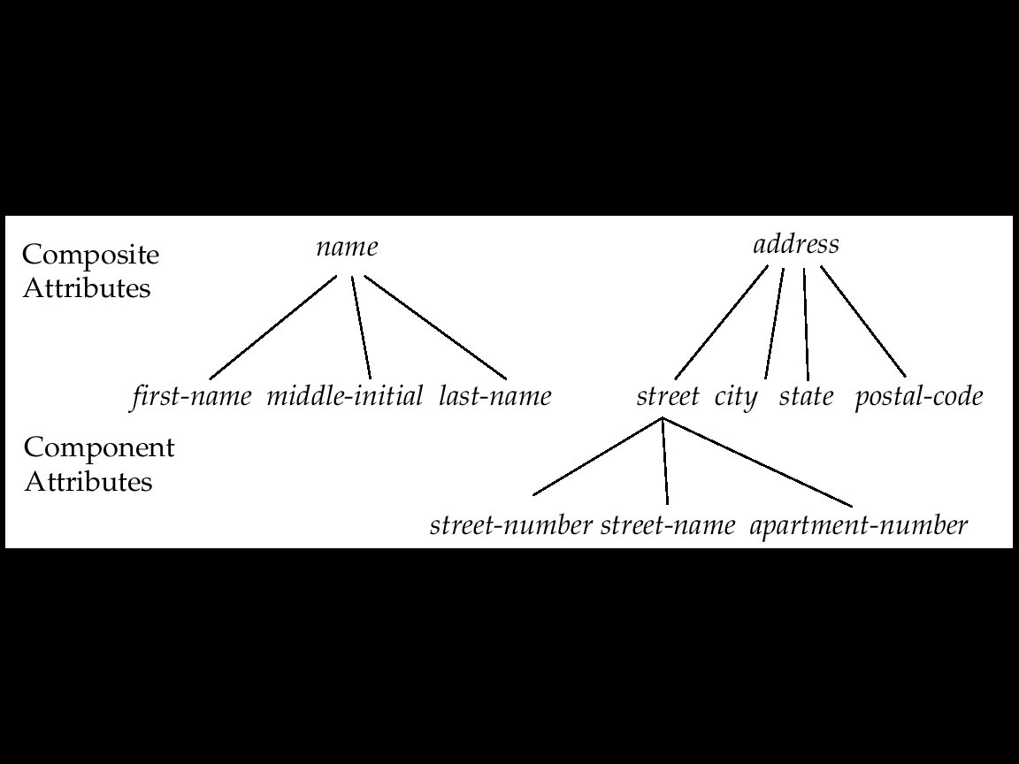
ER Diagram
Attribute Types
Simple and composite attributes.
Single-valued and multi-valued attributes
E.g. multi-valued attribute: phone-numbers
Derived attributes can be computed from other attributes
E.g. age, given date of birth

Slide 7
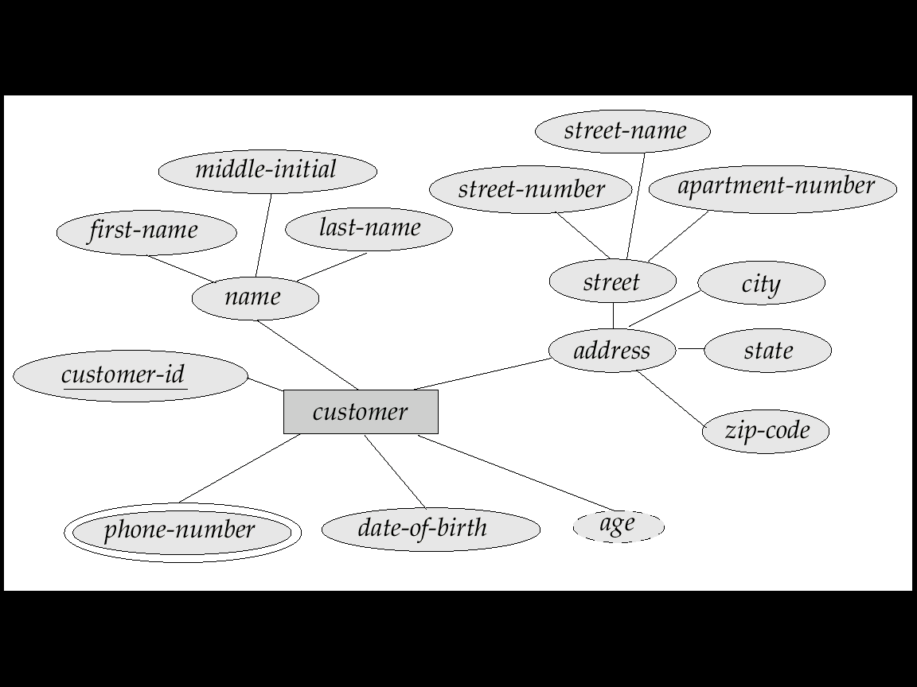
ER Diagram
Composite, Multivalued and Derived

Slide 8
ER Diagram
Relationship Sets
A relationship is an association among several entities
Example:
A relationship set is a mathematical relation among n ≥ 2 entities
An attribute can also be property of a relationship set.
Entity | Relationship | Entity
Sam | Deposit | A_102

Slide 9
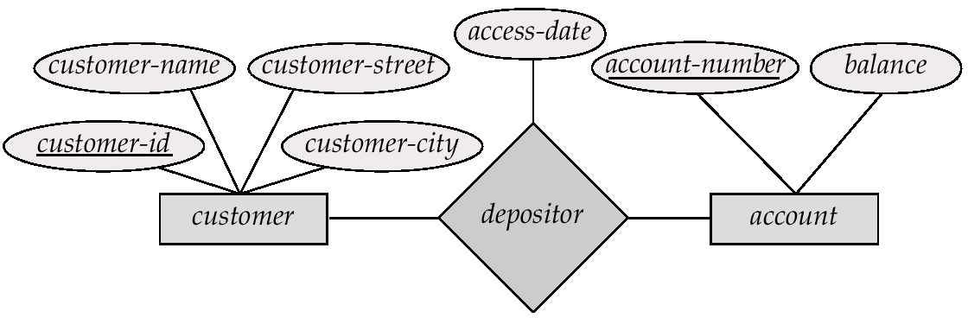
ER Diagram
Relationship Sets with Attributes

Slide 10
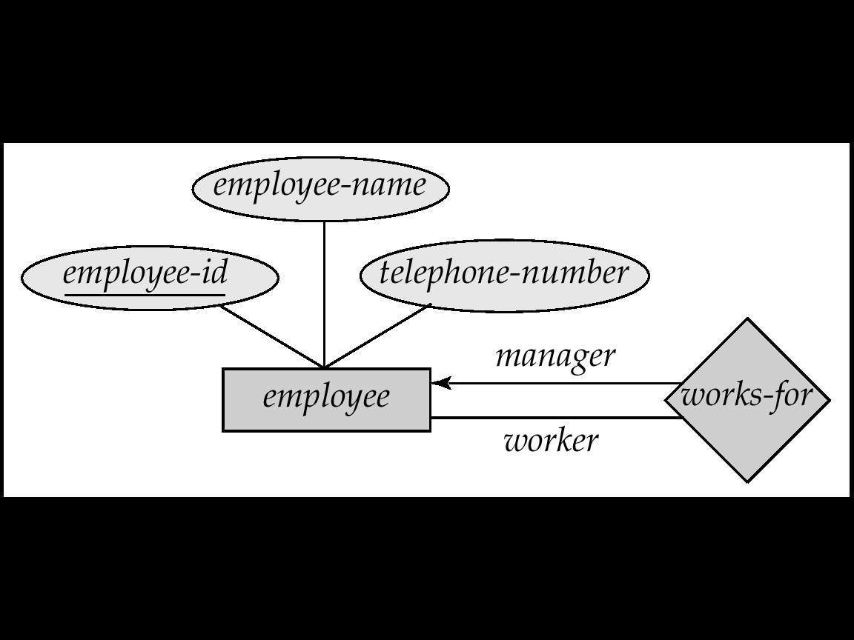
ER Diagram
Roles
Entity sets of a relationship need not be distinct
The labels “manager” and “worker” are called roles; they specify how employee entities interact via the works-for relationship set.
Roles are indicated in E-R diagrams by labeling the lines that connect diamonds to rectangles.
Role labels are optional, and are used to clarify semantics of the relationship

Slide 11
ER Diagram
Mapping Cardinality
Express the number of entities to which another entity can be associated via a relationship set.
Most useful in describing binary relationship sets.
Mapping Cardinalities affect ER Design
We express cardinality constraints by drawing either a directed line (→), signifying “one,” or an undirected line (—), signifying “many,” between the relationship set and the entity set.
For a binary relationship set the mapping cardinality must be one of the following types:
  One to one
  One to many
  Many to one
  Many to many

Slide 12
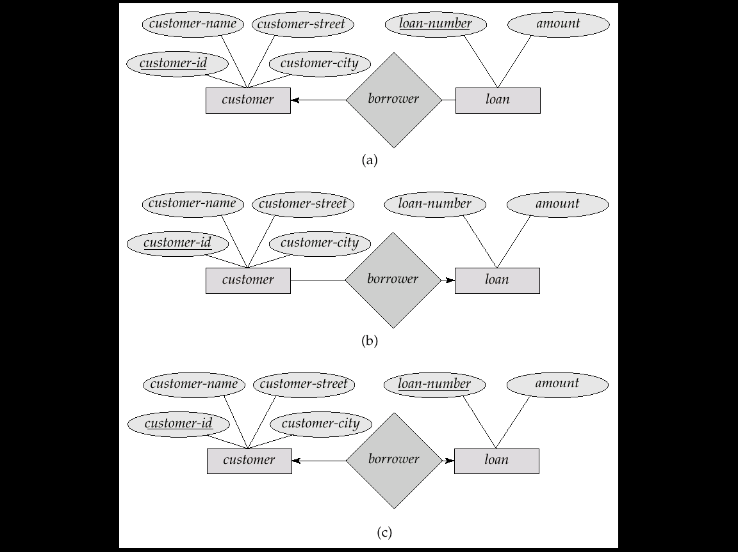
ER Diagram
One-to-One Relationship

Slide 13
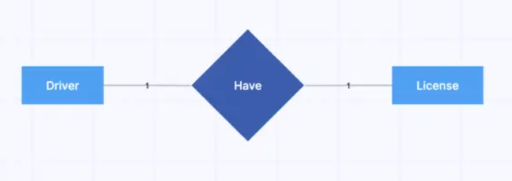
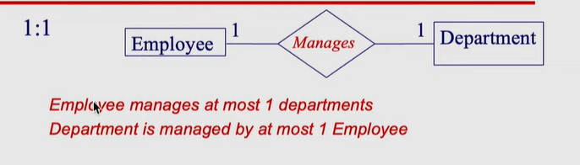
ER Diagram
One-to-One Relationship

Slide 14
ER Diagram
One-to-Many Relationship

Slide 15
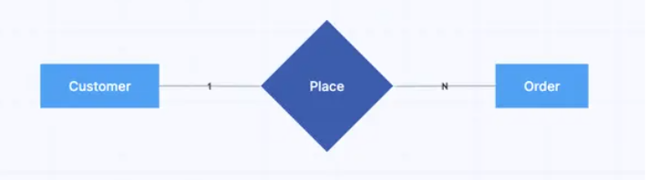
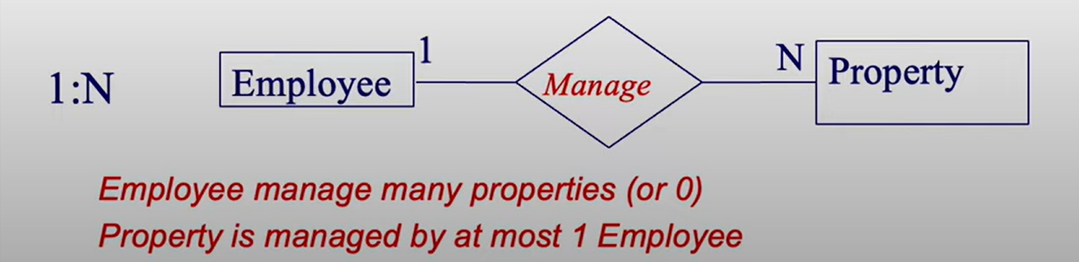
ER Diagram
One-to-Many Relationship

Slide 16
ER Diagram
Many-to-One Relationship

Slide 17
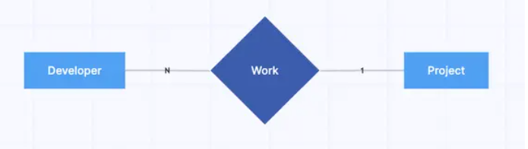
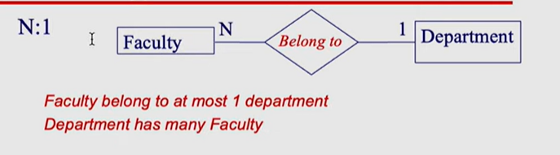
ER Diagram
Many-to-One Relationship

Slide 18
ER Diagram
Many-to-Many Relationship

Slide 19
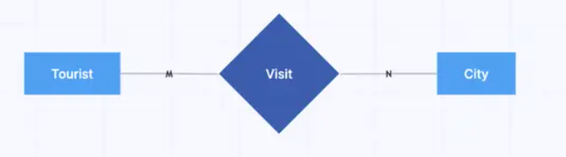
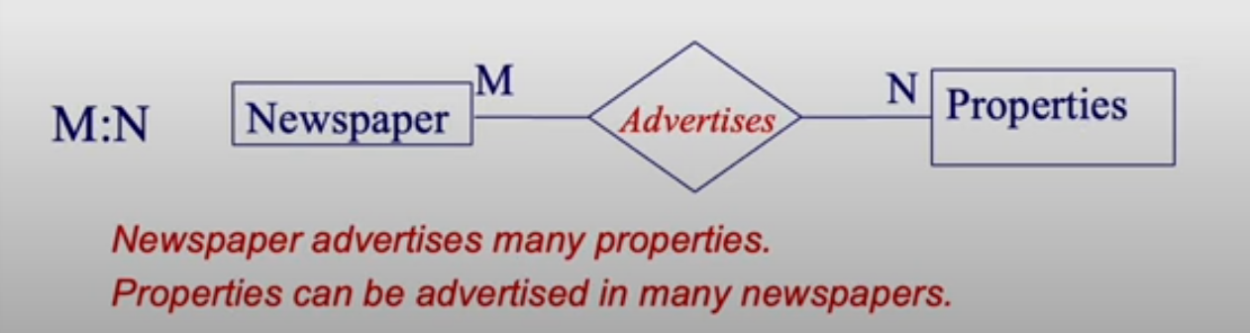
ER Diagram
Many-to-Many Relationship

Slide 20
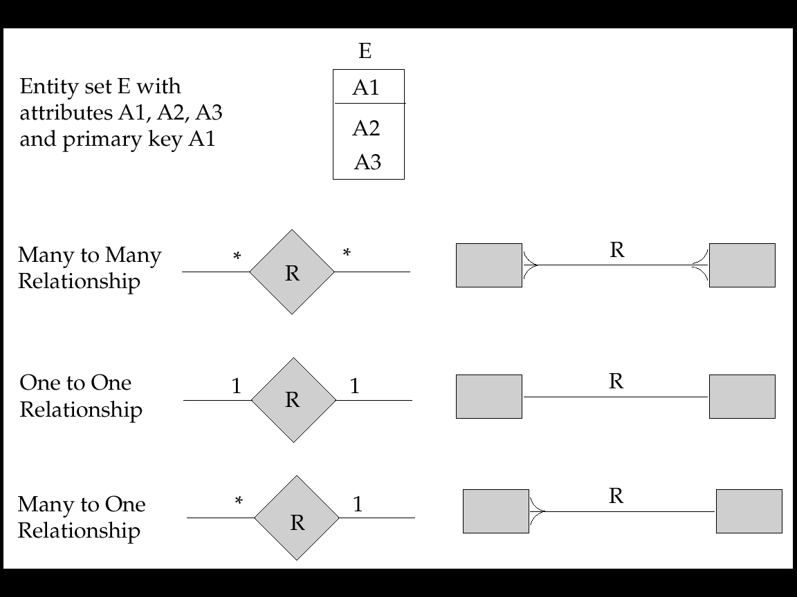
Alternate ER Notation

Slide 21
ER Diagram
Degree of a Relationship Set
Refers to number of entity sets that participate in a relationship set.
Relationship sets that involve two entity sets are binary (or degree two). Generally, most relationship sets in a database system are binary.
Relationship sets may involve more than two entity sets.
Relationships between more than two entity sets are rare. Most relationships are binary.

Slide 22
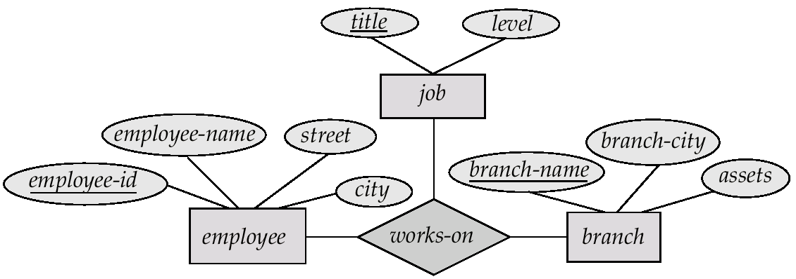
ER Diagram
Ternary Relationship

Slide 23
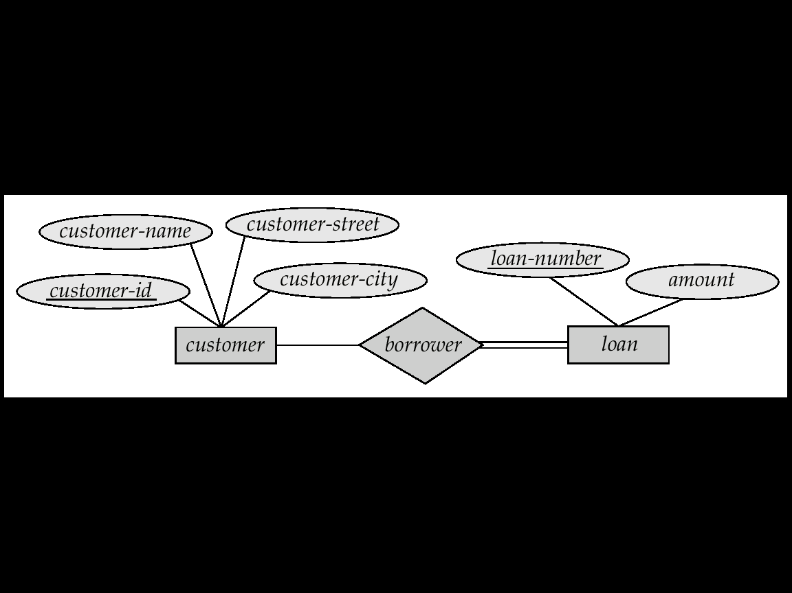
Participation
Total participation
Partial participation

Slide 24
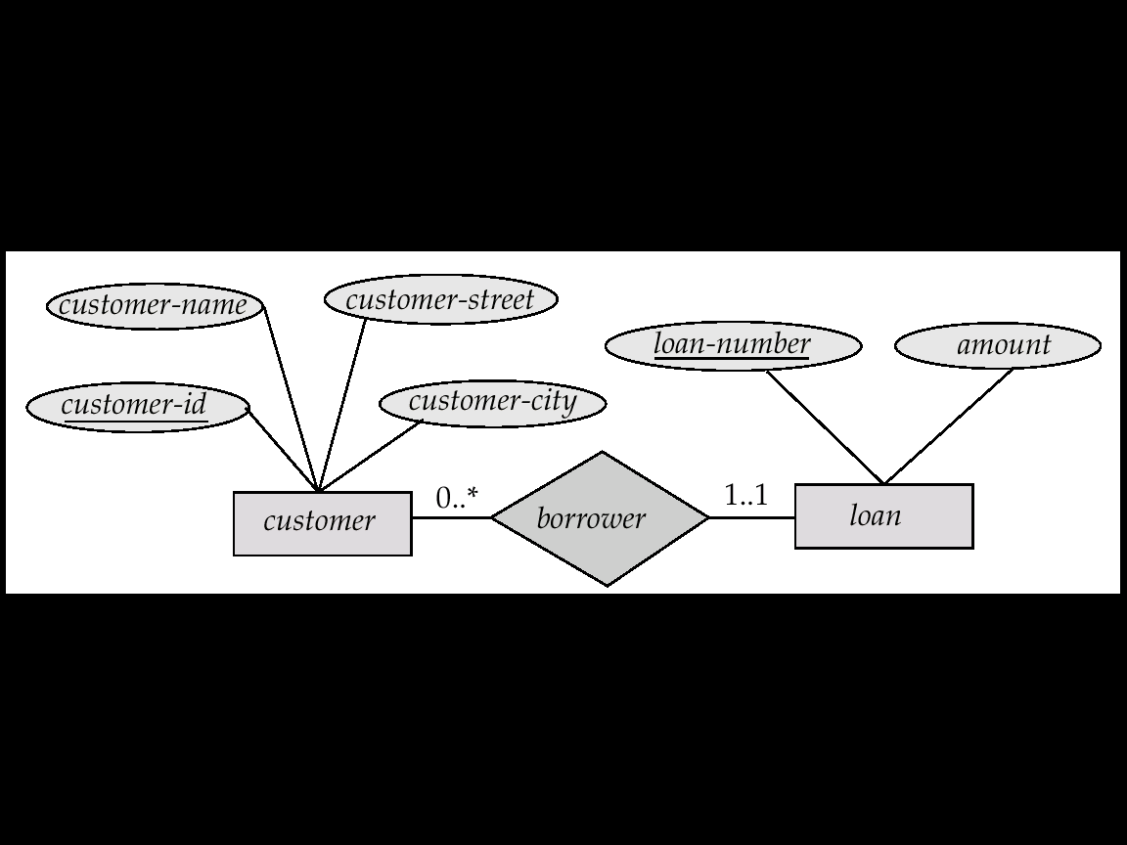
Cardinality Limits

Slide 25
Keys
A super key of an entity set is a set of one or more attributes whose values uniquely determine each entity.
A candidate key of an entity set is a minimal super key
Although several candidate keys may exist, one of the candidate keys is selected to be the primary key.
Every candidate key is a super key but, every super key may or may not be a candidate key.
Foreign Key of the entity attribute is the entity which is the primary key of the related entity. Foreign key helps to establish the mapping between two or more entities.

Slide 26
Weak Entity Sets
An entity set that does not have a primary key is referred to as a weak entity set.
The existence of a weak entity set depends on the existence of a identifying entity set
  it must relate to the identifying entity set via a total, one-to-many relationship set from the identifying to the weak entity set
  Identifying relationship depicted using a double diamond
The discriminator (or partial key) of a weak entity set is the set of attributes that distinguishes among all the entities of a weak entity set.
The primary key of a weak entity set is formed by the primary key of the strong entity set on which the weak entity set is existence dependent, plus the weak entity set’s discriminator.

Slide 27
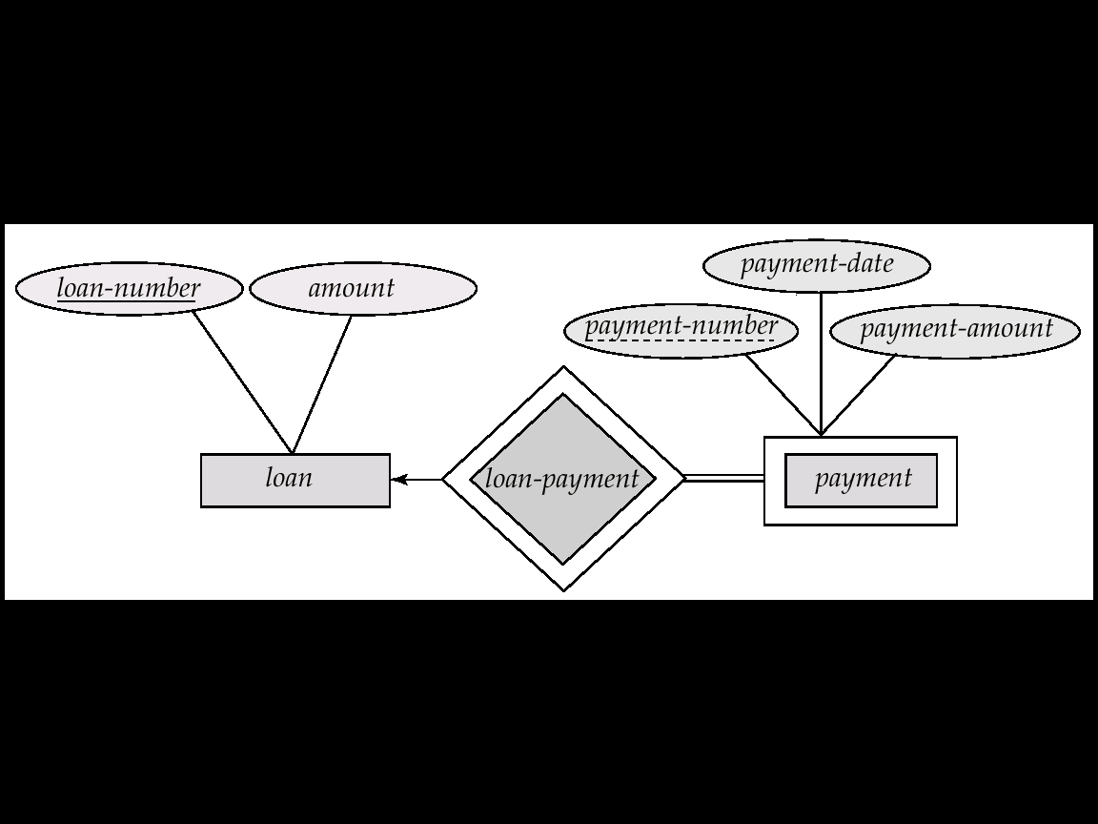
Weak Entity Sets
We depict a weak entity set by double rectangles.
We underline the discriminator of a weak entity set with a dashed line.
payment-number – discriminator of the payment entity set
Primary key for payment – (loan-number, payment-number)

Slide 28
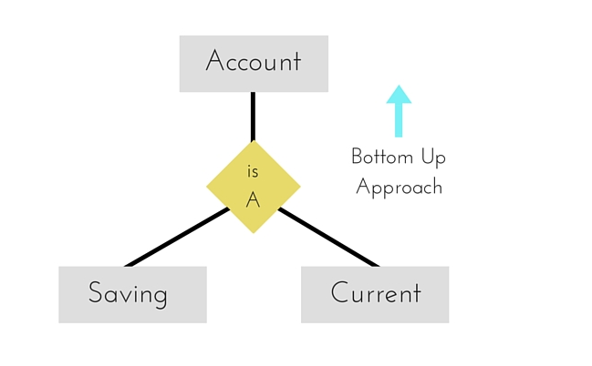
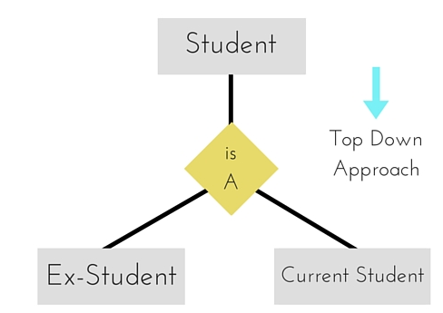
Generalization and Specialization

Slide 29
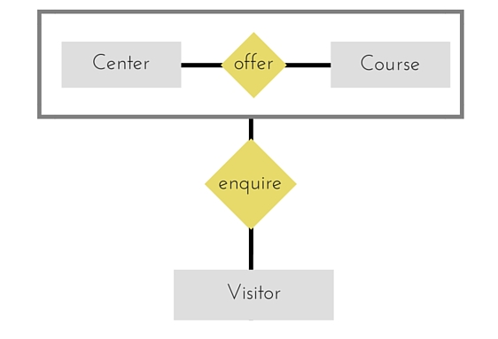
Aggregation

Slide 30
Books
Modern Database Management (Sixth Edition) by Fred R. McFadden, Jeffrey A. Hoffer, Mary B. Prescott
Database System Concepts (Fifth Edition) by Henry F. Korth, S. Sudarshan, A. Silberschatz
Oracle-database-10g-sql-fundamentals-1-student-guide-volume-1
SQL and Relational Theory: How to Write Accurate SQL Code by C.J. Date
Database Systems: A Practical Approach to Design, Implementation and Management (4th Edition) by Thomas M. Connolly, Carolyn E. Begg
Fundamentals of Database Systems, 5th Edition by RamezElmasri, Shamkant B. Navathe
Database Design and Relational Theory: Normal Forms and All That Jazz by C. J. Date
An Introduction to Database Systems 8th Edition, by C.J. Date

Slide 31
References
https://www.db-book.com/db6/slide-dir/index.html
https://docs.oracle.com/en/database/oracle/oracle-database/20/sqlrf/SQL-Standards.html#GUID-BCCCFF75-D2A4-43AD-8CAF-C3C97D92AC63
https://www.slideshare.net/HaaMeemMohiyuddin1/data-knowledge-and-information
https://www.slideshare.net/tabinhasan/from-data-to-wisdom
https://www.slideshare.net/thinnaphat.bo/

